Slide 1

TEAM 1 IT Architects
Credit Card Fraud Detection

Slide 2

Agenda
Team Members
Improvement from Professor
Problem Statement
Problem Description
Team Working Agreement
Project Personas
MVP
Product Design
Technology and Tools
Algorithms and Models
Diagrams
Sprint 1 Recap
Product Backlog
Sprint 2 Stories
Sprint 2 Test Cases
Stories Completed And Not Completed
Burn Down Chart
Sprint 2 Velocity
Historical and Average Velocities
Commited and Completed Ratios
Sprint Retrospective
Sprint 3 Planning Stories Carried Over
Application Screen Shot
Rest API
Wiki Page & GitHub Repository
Project Demo

Slide 3
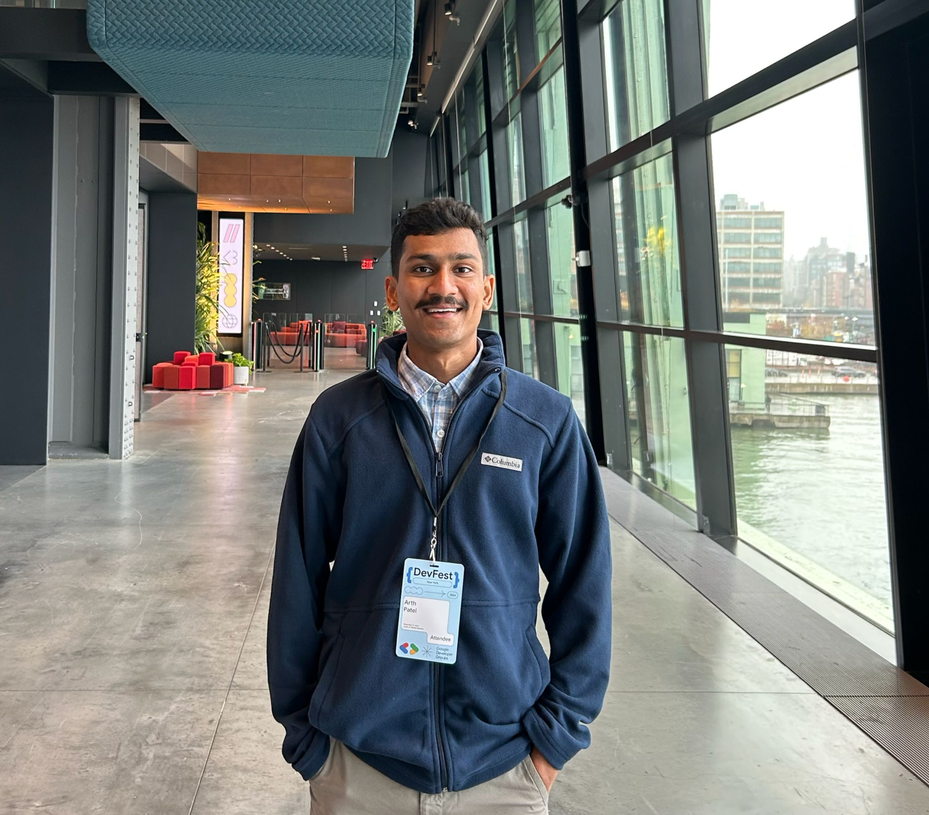
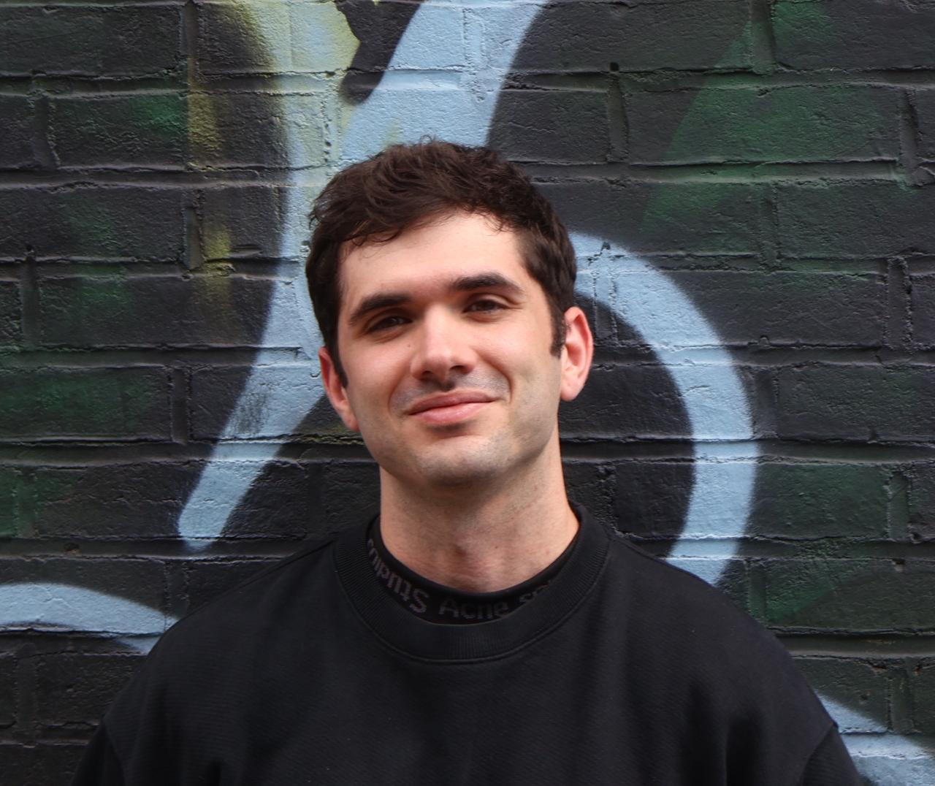
Team Members
Mr. Arth Patel
Role : Front-End Developer
Mr. Tyler Helmrich
Role: Scrum Master

Slide 4

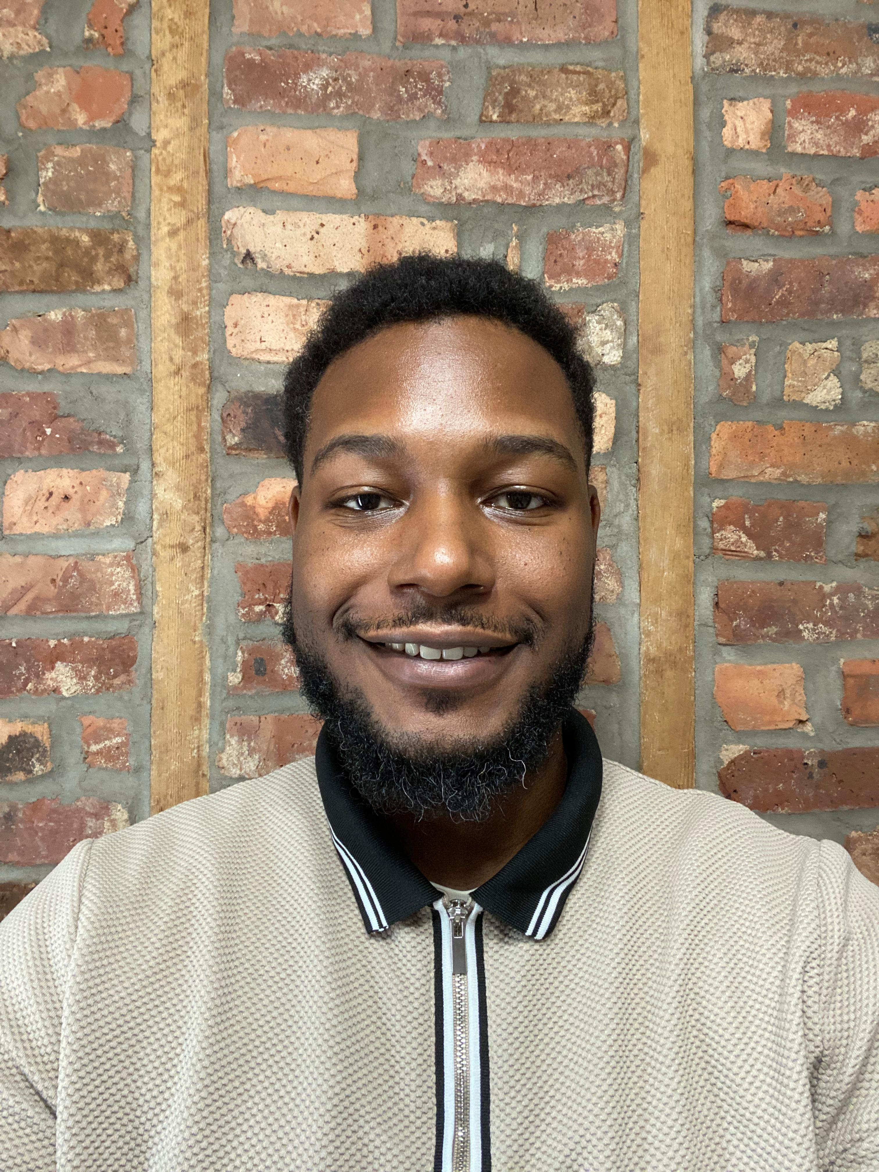
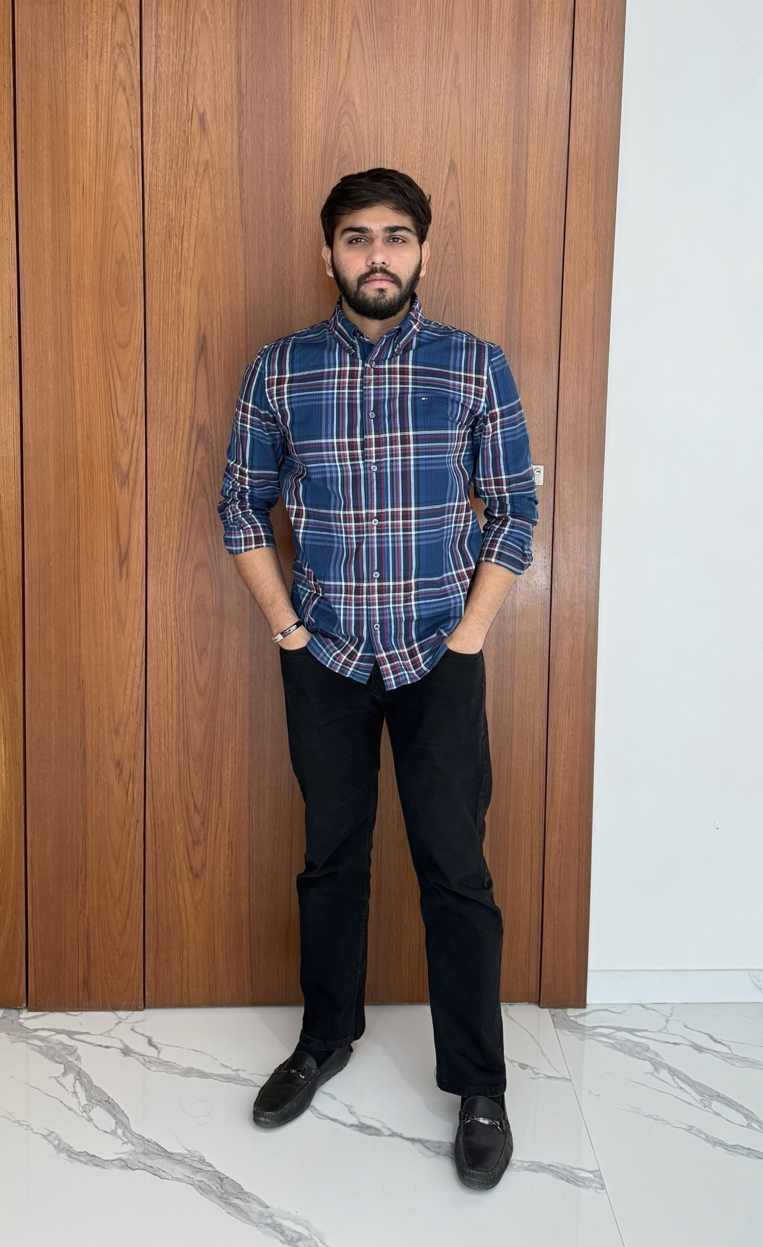
Mr. Jay Patel
Role: Back-End Developer
Mr. Xavier Jackon
Role: Machine Learning Lead
Mr. Zenil Moradia
Role: Quality assurance

Slide 5

Improvement from Professor
Some diagrams were incomplete or not done properly
Missing required Agile documents:
Team Working Agreement
MVP definition
Product Backlog
Sprint Velocity tracking
User stories were unclear and inconsistent.
Overall documentation quality needed improvement

Slide 6

Problem Statement
This persistent threat not only inflicts hundreds of millions of dollars in annual losses but also erodes consumer confidence in digital payments. Existing detection systems struggle to keep up with the evolving tactics of scammers and the extreme imbalance between legitimate and fraudulent transactions. There is an urgent need for a robust, real-time solution that can accurately flag while minimizing false alarms.
Credit card fraud remains the leading form of identity theft in the United States, with 2024 seeing over 449,000 complaints to the Federal Trade Commission and within the first quarter of 2025 adding another 151,000 cases. In the United States, 63% of cardholders have been targeted at least once, and more than half of these victims report experiencing repeated attacks.

Slide 7
Problem Description
Project Name: | "Classifi" - Credit Card Fraud Detection Mobile App utilizing a Classification Algorithm Machine Learning Model
Team: | IT Architects
Project Description: | This project aims to deliver an advanced machine-learning classifier for credit-card fraud detection, designed for issuers and cardholders frustrated by today’s rule-based systems and high false-alarm rates. Leveraging SMOTE to rebalance data and XGBoot for precision, we’ll identify fraudulent transactions before funds leave the account, reduce false positives on legitimate purchases, and trigger real-time alerts that let cardholders act immediately. Our mission is to replace rigid, hand-tuned rules with a data-driven model that adapts to evolving fraud patterns by minimizing losses, preserving reputations, and restoring trust in digital payments through a mobile iOS application that is easily accessible. Current deterrents include rule-based fraud detection techniques, whereas our goal is to implement an AI-powered fraud-detection service that catches up to 80% of fraud attempts in real time while cutting false positives by 30%, so issuers lose less money and cardholders enjoy seamless, secure spending.
Benefit Outcomes: | Credit Card companies can expect a reduction in false alarms, monetary losses, and damage to their reputation. Credit Card holders can expect a reduction in unauthorized charges, fewer declined legitimate transactions, and greater peace of mind when using their cards as well as an increase in user satisfaction and engagement.
Github Link: | https://github.com/htmw/F2025-Team1/wiki

Slide 8
Team Working Agreement
Communication & Collaboration - Our team will primarily communicate through WhatsApp, Teams, Discord and GitHub updates.
Whenever code is pushed to GitHub, members will notify the team to prevent conflicts or overwrites.
If anyone needs to adjust their task timeline or change their approach, they must inform the team beforehand.
Meeting Routine & Workflow - The team will meet twice weekly, typically on Saturday and Wednesday, unless additional sessions are required.
Anyone unable to attend a meeting must notify the team in advance and go through the meeting summary afterward.

Slide 9
Team Working Agreement Cont.
Team Working Principles - All tasks will include a clear deadline and will be reviewed once completed.
All contributions should be pushed to GitHub regularly with meaningful commit messages.
Complex tasks will be broken into smaller actionable items to balance workload.
Checklist for Marking a Task as Complete - The output should satisfy all acceptance criteria, such as correct preprocessing, expected model accuracy, or UI functionality.
All associated documentation, dataset changes should be updated.

Slide 10

Sarah is an avid online shopper who loves finding unique items from small businesses. She uses her credit card for most of her purchases, appreciating the convenience and rewards. She's tech-savvy and expects seamless digital experiences. Recently, her card details were stolen from a third-party website, leading to several unauthorized small purchases. The process of getting a new card and updating her payment information on various subscriptions was a significant hassle and made her wary of future online transactions. She's looking for reassurance and security in her digital financial interactions.
Goals:
Wants to shop online without constant worry about card fraud.
Needs quick and clear notifications for any suspicious activity on her accounts.
Hopes for an easy way to verify transactions or freeze her card directly from her phone if needed.
Frustrations:
The time and effort involved in cancelling cards and updating payment details after fraud.
Feeling vulnerable and exposed when her financial information is compromised.
Receiving generic, unhelpful alerts that don't provide clear next steps.
Needs from the Solution:
Real-time alerts that are easy to understand and act upon.
An intuitive mobile interface that allows her to quickly approve or deny a transaction and temporarily lock her card.
Minimal false positives on her legitimate purchases so she doesn't lose trust in the system.
Persona 1: Sarah Miller
Age: 28
Occupation: Graphic Designer

Slide 11
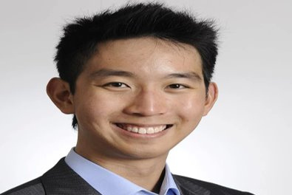
Age: 32
Occupation: Founder of "PetPals Boutique" | The E-commerce Startup Founder
Alex recently launched "PetPals Boutique," an online store selling custom pet accessories. Business is booming, but he's starting to see adisturbing trend of chargebacks due to fraudulent orders. These chargebacks not only cost him money but also damage his store's reputationwith payment processors. He's passionate about his business but has limited resources and can't afford a dedicated fraud team. He needs automated, intelligent system that can protect his revenue and allow him to focus on growing PetPals Boutique, not fighting fraud.
Goals:
To minimize chargebacks and financial losses from fraudulent transactions.
To protect his business's reputation with payment providers.
To have a simple, affordable, and effective fraud detection solution that integrates easily with his e-commerce platform.
Frustrations:
The financial impact of fraudulent orders and chargeback fees.
The time-consuming process of manually reviewing suspicious orders.
Fear that his small business could be targeted by organized fraud rings, which he feels ill-equipped to handle.
Needs from the Solution:
An easy-to-integrate API that works seamlessly with his e-commerce platform.
A dashboard that provides clear, actionable insights on potential fraud, without requiring a lot of technical expertise.
Automated decision-making that blocks high-risk transactions instantly and allows low-risk ones to proceed without delay.
Persona 2: Alex Chen
Age: 32
Occupation: Founder of "PetPals Boutique" | The E-commerce Startup Founder

Slide 12
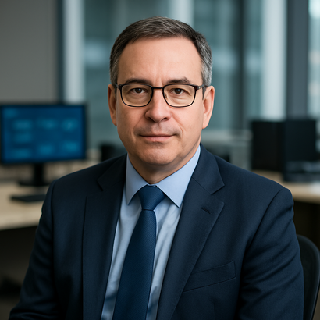
Marcus leads the fraud prevention department at a mid-sized bank. His team handles thousands of credit card transactions daily, constantly battling sophisticated fraud schemes. With new tactics emerging all the time, his biggest challenge is staying ahead of the criminals while ensuring legitimate customer transactions are processed smoothly. He's looking for a powerful, scalable solution that can integrate with their existing systems, reduce false positives, and provide actionable intelligence to his team. He needs to improve detection rates, reduce operational costs associated with fraud investigation, and enhance customer trust.
Goals:
To significantly reduce the bank's annual losses from credit card fraud.
To decrease the rate of false positives, improving customer experience and reducing operational overhead.
To implement a system that provides real-time, adaptive fraud detection capable of learning new patterns.
Frustrations:
The constant arms race with fraudsters and the difficulty of keeping up with evolving tactics.
The pressure to maintain a high level of security without inconveniencing legitimate customers.
The sheer volume of data and the challenge of sifting through it to find genuine fraud.
Needs from the Solution:
A highly scalable system that can process millions of transactions in real time.
Advanced machine learning capabilities that can adapt to new fraud patterns and minimize false positives.
Persona 3: Marcus Johnson
Age: 49
Occupation: Head of Fraud Prevention at "Secure Bank"

Slide 13
MVP
Real-Time Fraud Predictions – System analyzes incoming transactions instantly.
Interactive Dashboard – Users can visualize fraud alerts, risk scores, and patterns through graphs & metrics.
Simple, Accessible UI – Easy for non-technical users to understand fraud insights at a glance.
API-Driven Architecture – Front-end fetches predictions seamlessly through backend REST APIs.
Notification/Alert System (TBD) – Email/SMS alerts for high-risk transactions (future enhancement).

Slide 14


Technology and Tools
Data Storage, Collection, and Processing
Pandas / NumPy – Core tabular and numerical routines.
Model Development and Experimentation
XGBoost – Gradient boosting implementations with GPU support for speed and advanced class‐imbalance handling.
Python – widely used language for AI model development because of its simplicity, readability, and powerful ecosystem of libraries and frameworks.
PenPot – a free, open-source, web-based design and prototyping tool built for collaboration between designers and developers.
XCODE – Apple’s official IDE for building apps across all Apple platforms.
Swift – Apple’s modern, powerful, and intuitive programming language designed for building Apple Platform apps on XCODE.
Kaggle – Online repository of public datasets. We used this to acquire the training data set for our model.
Scikit-learn – Standardized pipeline, preprocessing, and model‐selection tools.
FastAPI – a modern, high-performance Python web framework designed for building APIs quickly and efficiently.
Visualization and End-User Interface
Supabase – an open-source backend-as-a-service (BaaS) platform that provided us with a full suite of tools—database, authentication, storage, real-time subscriptions, and serverless functions.

Slide 15
Algorithms and Models
Problem Solver | SMOTE | Synthetic Minority Over-sampling Technique. Used to mathematically generate new fraud examples on the training data to address the severe class imbalance (99.83% legitimate) and ensure the model learns fraud patterns.
Classifier | XGBoost | The eXtreme Gradient Boosting algorithm. Selected for its strength with tabular data and internal mechanisms to effectively maximize Recall (catching fraud) and maintain high Precision (minimizing false positives).

Slide 16
Diagrams

Slide 17
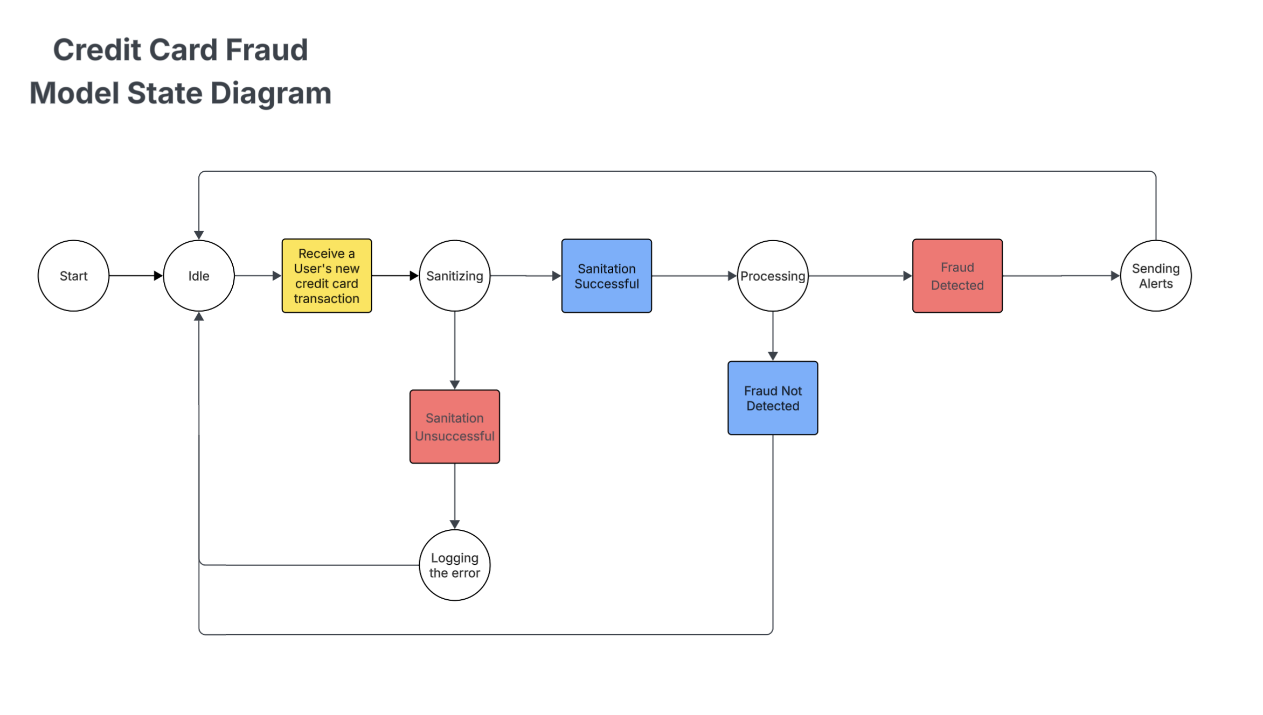
State Diagram

Slide 18
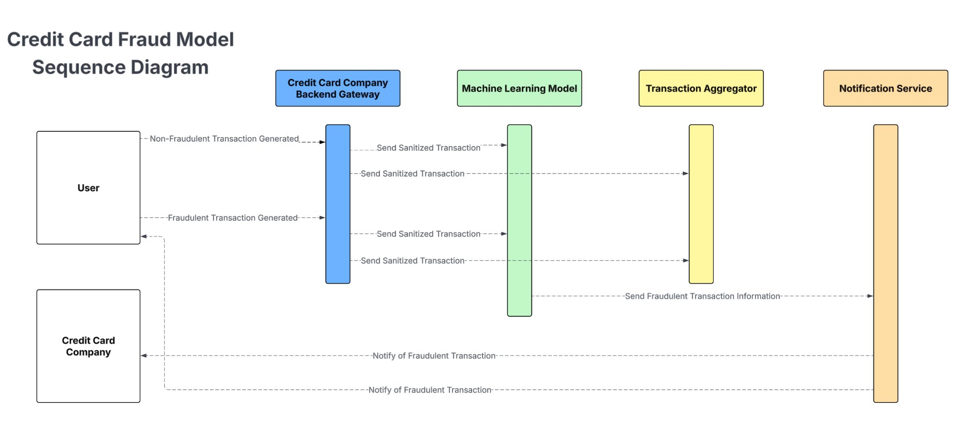
Sequence Diagram

Slide 19
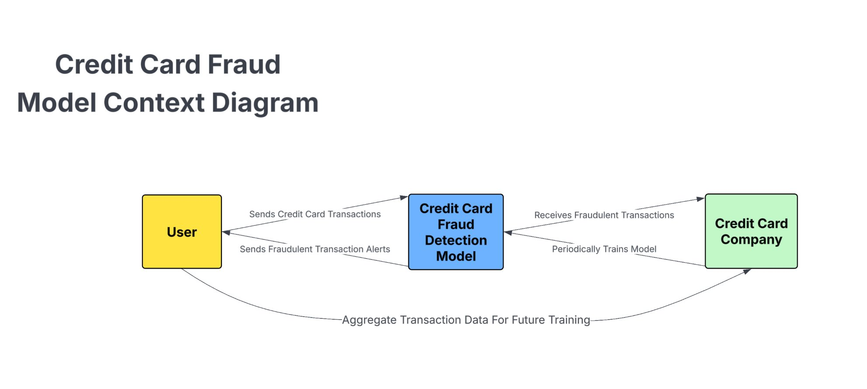
Context Diagram

Slide 20
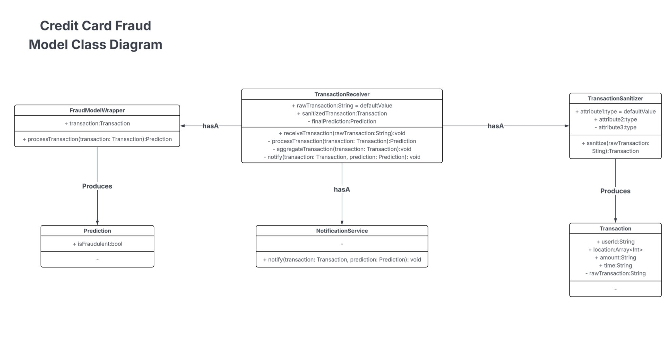
Class Diagram
Notes:
Defines the high level classes in our system
Receiver is responsible for taking in raw transaction data.
Sends it to a model that produces a prediction
Reciever takes prediction and then alerts

Slide 21
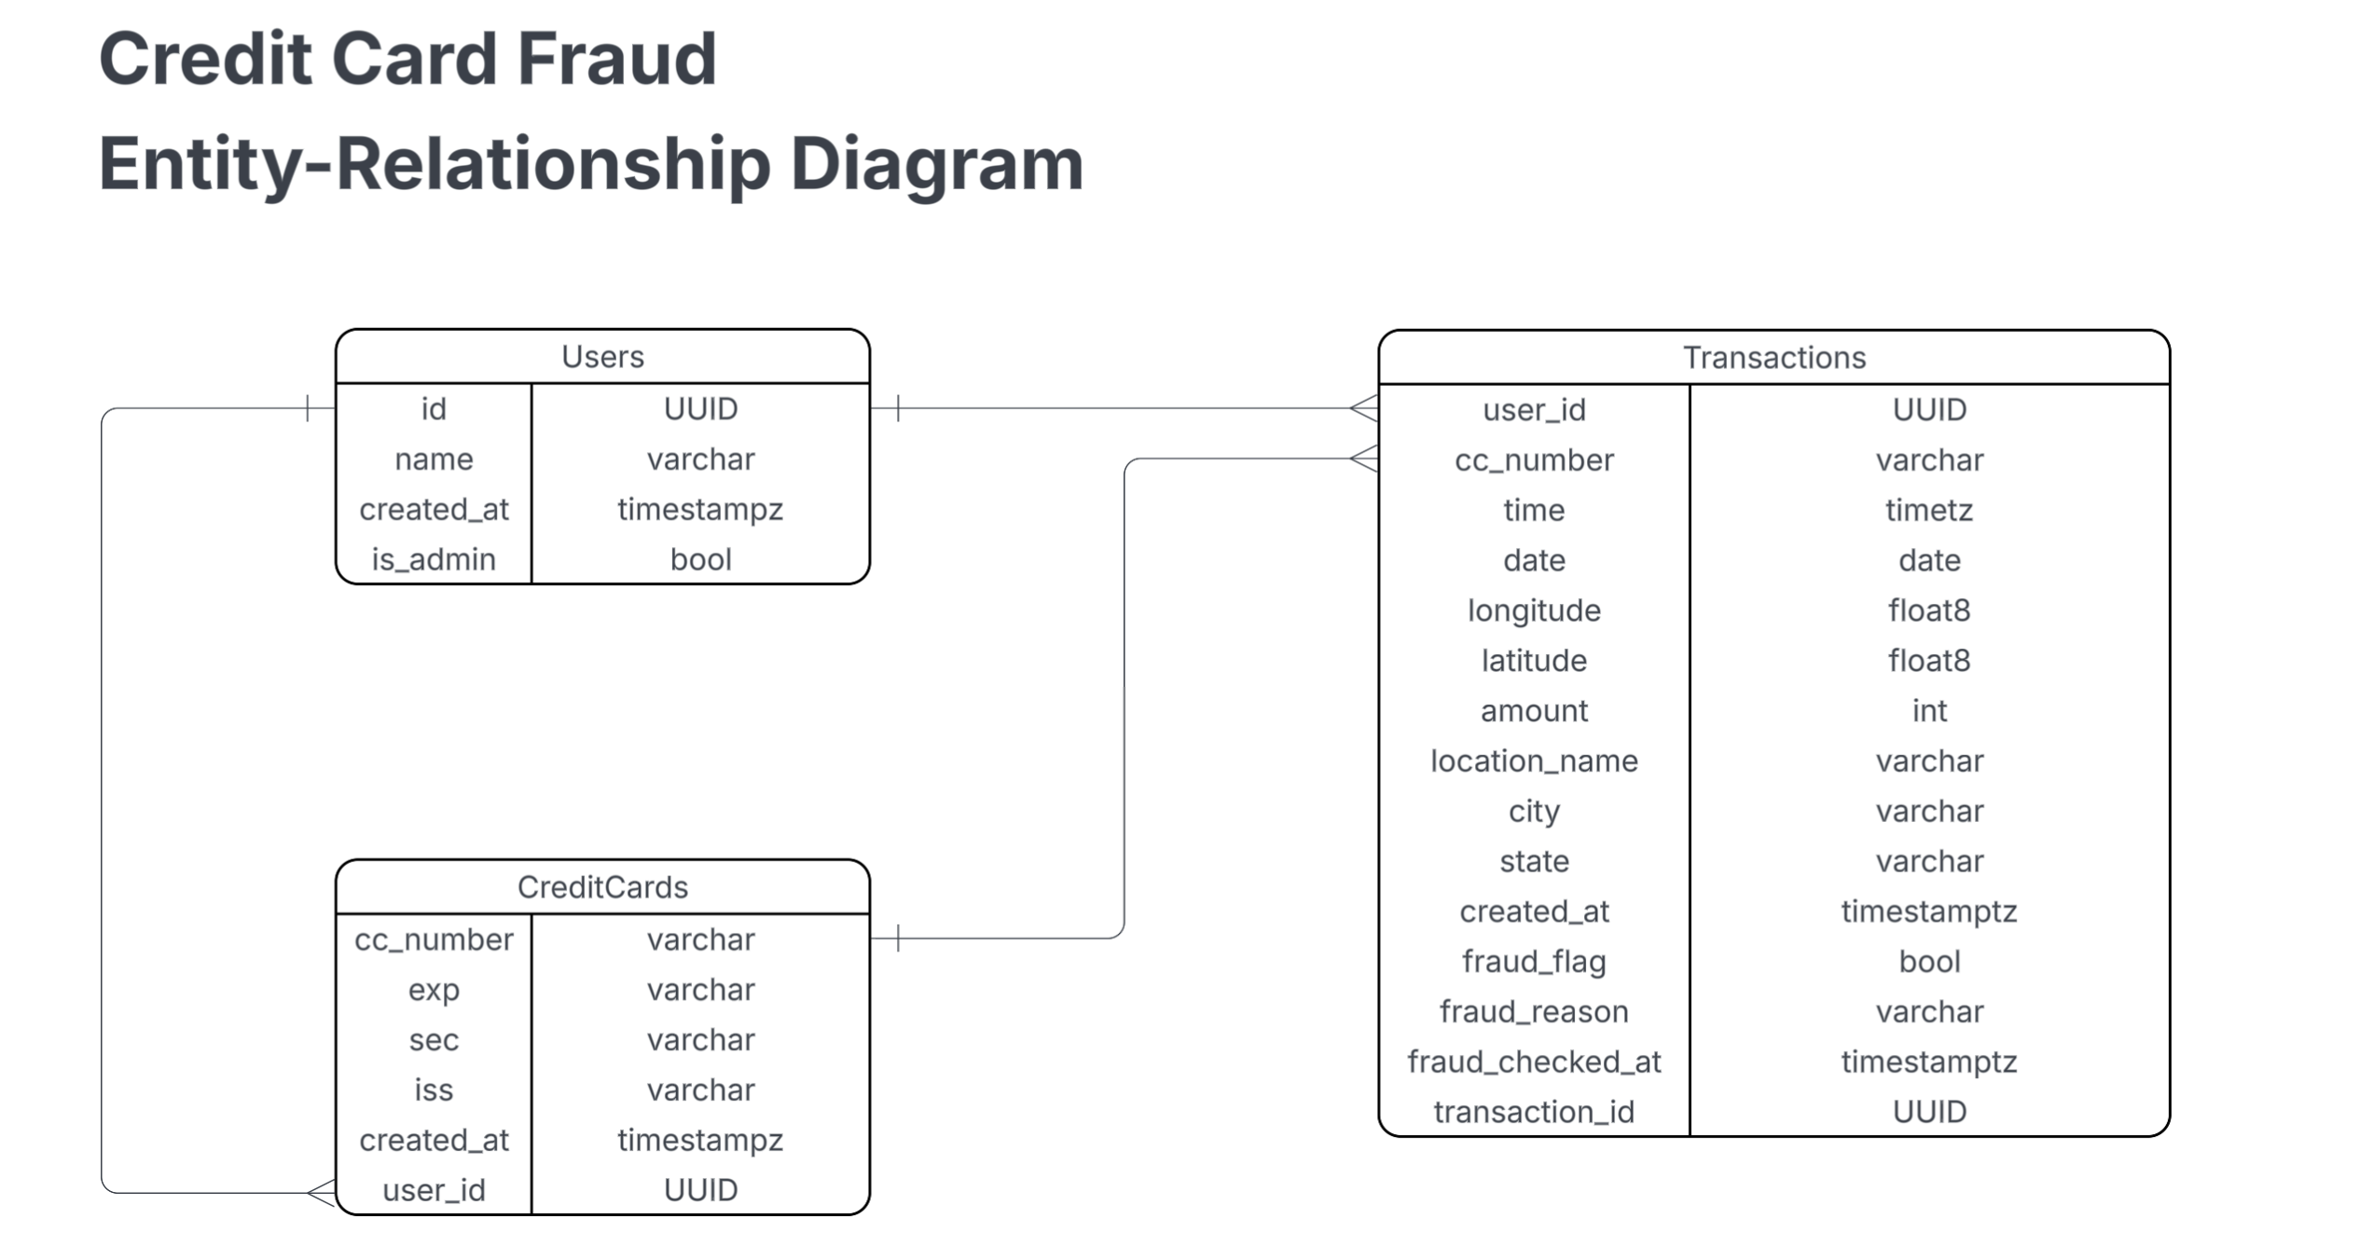
Entity-Relationship Diagram

Slide 22
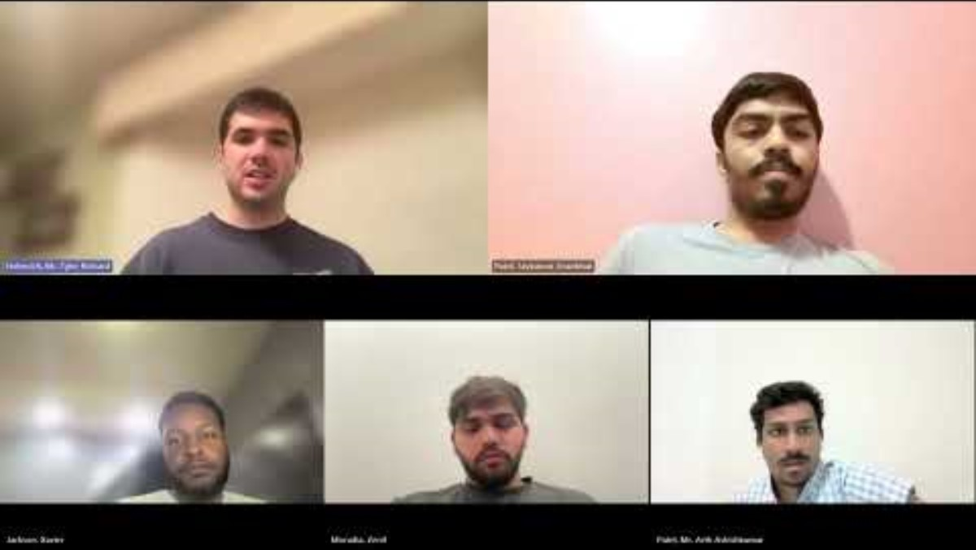
Sprint-1 Recap
In our Sprint-1 we began the process of building our credit card fraud detection model
We built a working model to detect credit card fraud that leveraged XGBoost, SMOTE, and credit card transaction data from Kaggle
Our live demo consisted of a generator application that could generate a mock transaction with model features we could control
To the right is a link to the start of our live demo to refresh your memory

Slide 23
Product Backlog
S.NO | User Story | Acceptance Criteria | Story Points
US_01 | As a user, I want to securely register and log in so that my financial data remains protected. | User can sign up, log in, and authentication is validated using encrypted credentials and session tokens. | 5
US_02 | As a user, I want to link my credit card so that the system can analyze transactions for fraud. | User can add, validate, and save encrypted card details. | 5
US_03 | As the system, I want to ingest real-time transactions so that fraud detection happens instantly. | System successfully receives, validates, and stores transaction streams in the database. | 8
US_04 | As a fraud analyst, I want to review risky transactions so that I can quickly take action. | Analysts can view flagged transactions with risk scores and transaction details. | 5
US_05 | As a user, I want to receive alerts when suspicious activity occurs so that I can respond immediately. | Alerts trigger when fraud score exceeds threshold via dashboard notification. | 5

Slide 24
Product Backlog
S.NO | User Story | Acceptance Criteria | Story Points
US_06 | As the system, I want to run ML models to detect fraudulent patterns so that high-risk transactions are identified. | ML model generates fraud probability score for every transaction. | 8
US_07 | As an admin, I need to secure access to my dashboard so that no unauthorized person can view sensitive data. | Admin dashboard is protected with role-based access control and audit logging. | 5
US_08 | As a fraud analyst, I want a rule-based engine so I can define custom fraud rules. | Analysts can create and activate rules such as amount limits or location mismatch. | 5
US_09 | As a user, I want to view spending analytics so I can understand my financial behavior. | Dashboard displays charts for spending patterns, merchants, and time-based trends. | 3
US_10 | As a fraud analyst, I want to mark transactions as fraud or safe for model learning. | Analyst can update labels, add notes, and change case status. | 5

Slide 25
Product Backlog
S.NO | User Story | Acceptance Criteria | Story Points
US_11 | As a user, I want to file a chargeback for confirmed fraudulent transactions. | User can generate a chargeback request with required transaction information. | 5
US_12 | As an admin, I want to manage and verify financial institutions integrating with our system. | Admin can approve or reject banks after verifying API credentials. | 5
US_13 | As the system, I want to log all fraud-related events so that investigators can review them later. | Every fraud-related action is saved with timestamp, reviewer notes, and device metadata. | 3
US_14 | As a fraud analyst, I want heatmaps of unusual behavior so that anomalies are easier to detect visually. | System generates heatmaps for time-based, location-based, and merchant-based anomalies. | 8
US_15 | As a user, I want OTP verification for high-risk login attempts so that my account stays protected. | OTP is sent on suspicious logins and must be verified to continue. | 5

Slide 26
Sprint-2 Stories
S.NO | User Story | Acceptance Criteria | Feature | Story Points
US_02 | As a user, I want to link my credit card so that the system can start monitoring transactions for fraud. | User can add a card, Luhn validation passes, and card is stored securely. | Credit Card Linking | 3
US_03 | As the system, I want to ingest transactions so that fraud analysis can begin immediately. | System receives, validates, and stores transaction data automatically. | Transaction Ingestion | 5
US_15 | As an admin, I want analytic reports so that I can review overall fraud trends monthly. | Monthly reports generated automatically with charts. | Fraud Reporting Engine | 5

Slide 27
Sprint-2 Stories
S.NO | User Story | Acceptance Criteria | Feature | Story Points
US_06 | As the system, I want to run a machine learning fraud detection model so that fraudulent patterns can be identified. | Model generates probability score (0–1) for each transaction. | ML Fraud Detection Model | 8
US_07 | As a fraud analyst, I want to mark transactions as fraud or safe so that the model improves over time. | Analyst can label transactions and add case notes. | Case Management | 3
US_10 | As an admin, I want to manage system roles so that access controls are enforced. | Admin can assign roles (user, analyst, admin) with RBAC. | Role-Based Access Control | 3

Slide 28
Sprint-2 Stories
S.NO | User Story | Acceptance Criteria | Feature | Story Points
US_12 | As a user, I want to file a dispute for fraudulent charges so the bank can take action. | User fills dispute form linked to a specific transaction. | Fraud Dispute Filing | 3
US_13 | As the system, I want to maintain audit logs so that all actions related to fraud can be reviewed. | Every important action logged with timestamp, user, device info. | Audit Log System | 2
US_14 | As a user, I want to enable/disable fraud notifications so I have control over alerts. | User can toggle notification preferences in settings. | Notification Settings | 2

Slide 29
Sprint-2 Test Cases
US_ID | TC_ID | Test Case | Steps | Execution Status | Result
US_05 | TC_31 | Trigger Fraud Alert for Suspicious Transaction | 1. Login as Customer 2. Perform high-value transaction 3. Check system fraud alert 4. Validate alert is logged | Fraud alert should trigger | Pass
US_06 | TC_33 | Approve/Decline Suspicious Transaction | 1. Login as Analyst 2. Open fraud alert 3. Approve/Decline 4. Add notes 5. Submit | Decision recorded | Pass
US_12 | TC_39 | Export Monthly Fraud Report | 1. Login as Admin 2. Go to Reports 3. Generate Monthly Report 4. Download PDF/Excel | Report exported | Pass

Slide 30
Sprint-2 Test Cases
US_ID | TC_ID | Test Case | Steps | Execution Status | Result
US_09 | TC_36 | Customer Receives Fraud Notification | 1. Trigger fraud 2. System blocks card 3. Notification sent SMS/Email 4. Verify message | Notification received | Pass
US_10 | TC_37 | False Positive Check – Legit Transaction | 1. Perform normal transaction 2. Model evaluates 3. No fraud alert 4. Transaction succeeds | Transaction allowed | Pass
US_11 | TC_38 | Fraud Analyst Cannot View Restricted Cases | 1. Login as Analyst A 2. Try accessing Analyst B’s case 3. Access should be blocked | Unauthorized access blocked | Fail

Slide 31
Stories Completed And Not Completed
S.NO | User Story | Story Points | Completed | Date Completed
US_02 | As a user, I want to link my credit card so that the system can start monitoring transactions for fraud. | 3 | 3 | Nov 4
US_03 | As the system, I want to ingest transactions so that fraud analysis can begin immediately. | 5 | 5 | Nov 12
US_15 | As an admin, I want analytic reports so that I can review overall fraud trends monthly. | 5 | 0 | -
US_06 | As the system, I want to run a machine learning fraud detection model so that fraudulent patterns can be identified. | 8 | 8 | Nov 16
US_07 | As a fraud analyst, I want to mark transactions as fraud or safe so that the model improves over time. | 3 | 3 | Nov 12
US_10 | As an admin, I want to manage system roles so that access controls are enforced. | 3 | 0 | _

Slide 32
Stories Completed And Not Completed
S.NO | User Story | Story Points | Completed | Date Completed
US_12 | As a user, I want to file a dispute for fraudulent charges so the bank can take action. | 3 | 0 | -
US_13 | As the system, I want to maintain audit logs so that all actions related to fraud can be reviewed. | 2 | 0 | -
US_14 | As a user, I want to enable/disable fraud notifications so I have control over alerts. | 2 | 0 | -

Slide 33
Metrics

Slide 34
Burn-down chart

Slide 35
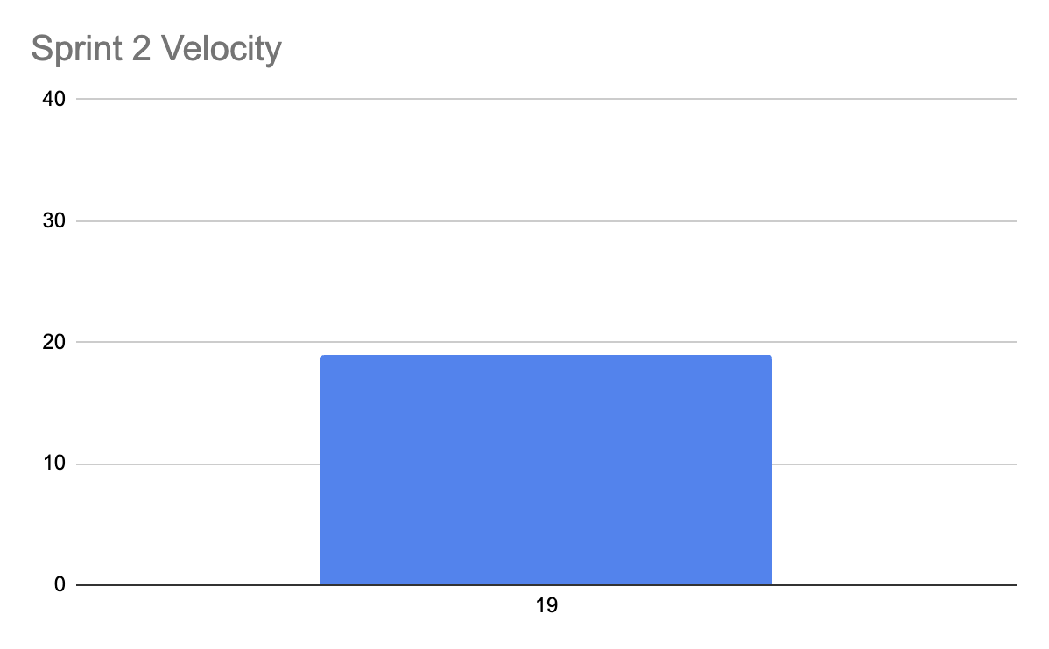
Sprint 2 Velocity Chart

Slide 36
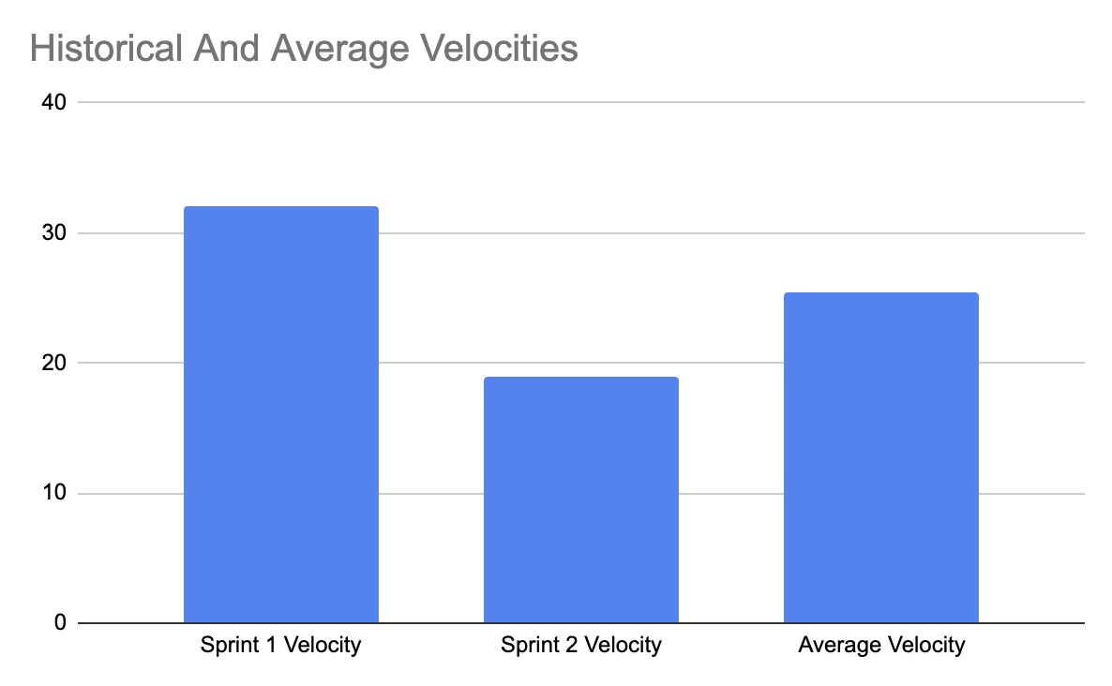
Historical & Average Velocities

Slide 37
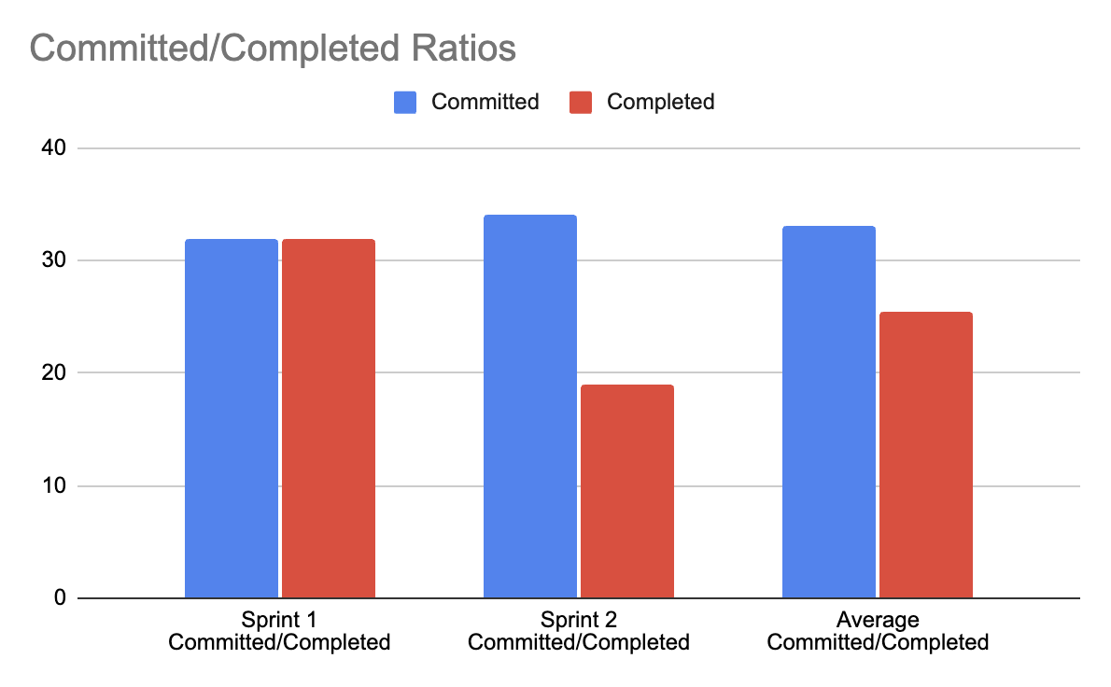
Committed & Completed Ratios

Slide 38
Sprint Retrospective
Video can be viewed here: https://youtu.be/Yizxb-Xj3eM

Slide 39
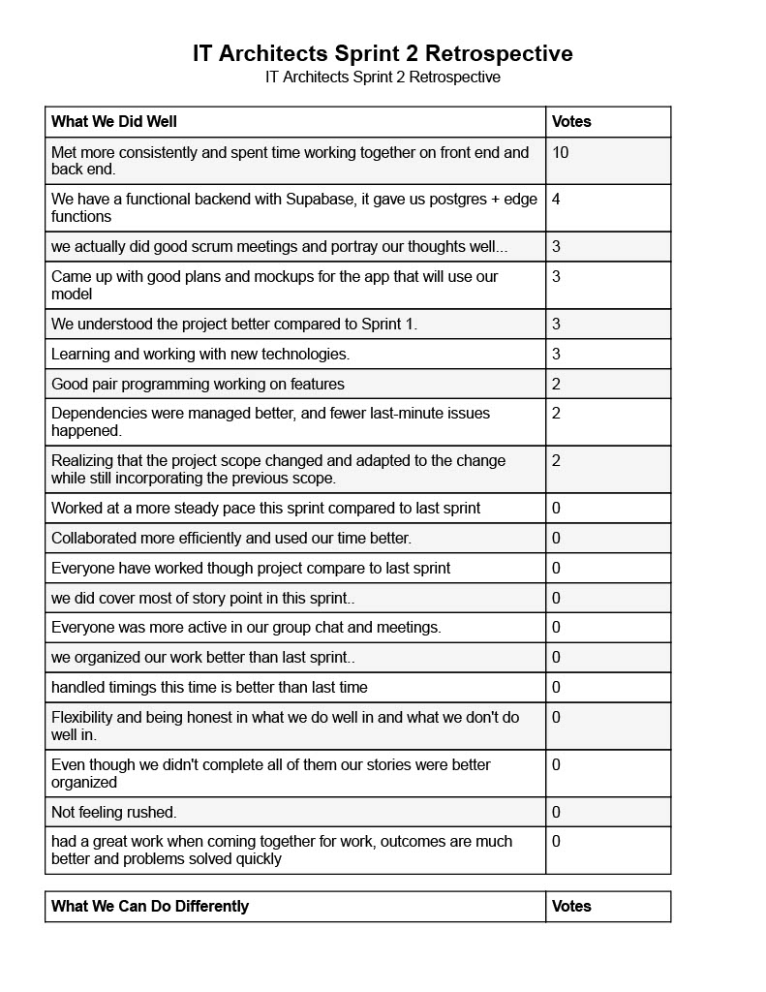
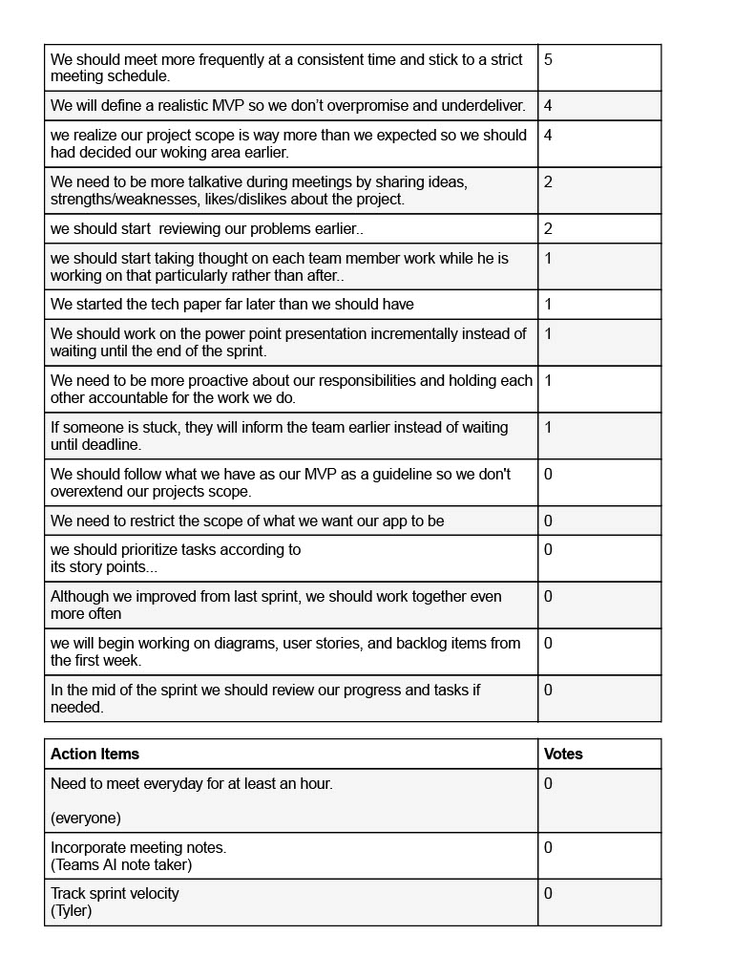
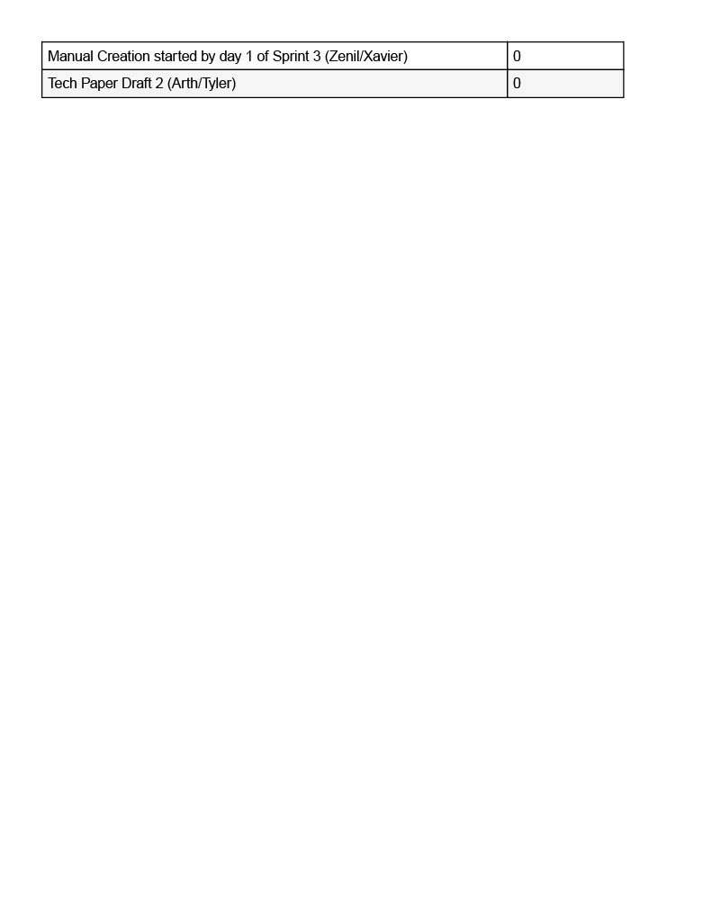
Sprint Retrospective

Slide 40

Sprint-3 Planning Stories Carried Over
S.NO | User Story | Acceptance Criteria | Feature | Story Points
US_10 | As an admin, I want to manage system roles so that access controls are enforced. | Admin can assign roles (user, analyst, admin) with RBAC. | Role-Based Access Control | 3
US_12 | As a user, I want to file a dispute for fraudulent charges so the bank can take action. | User fills dispute form linked to a specific transaction. | Fraud Dispute Filing | 3
US_13 | As the system, I want to maintain audit logs so that all actions related to fraud can be reviewed. | Every important action logged with timestamp, user, device info. | Audit Log System | 2
US_14 | As a user, I want to enable/disable fraud notifications so I have control over alerts. | User can toggle notification preferences in settings. | Notification Settings | 2
US_15 | As an admin, I want analytic reports so that I can review overall fraud trends monthly. | Monthly reports generated automatically with charts. | Fraud Reporting Engine | 5
As an admin, I want analytic reports so that I can review overall fraud trends monthly.

Slide 41
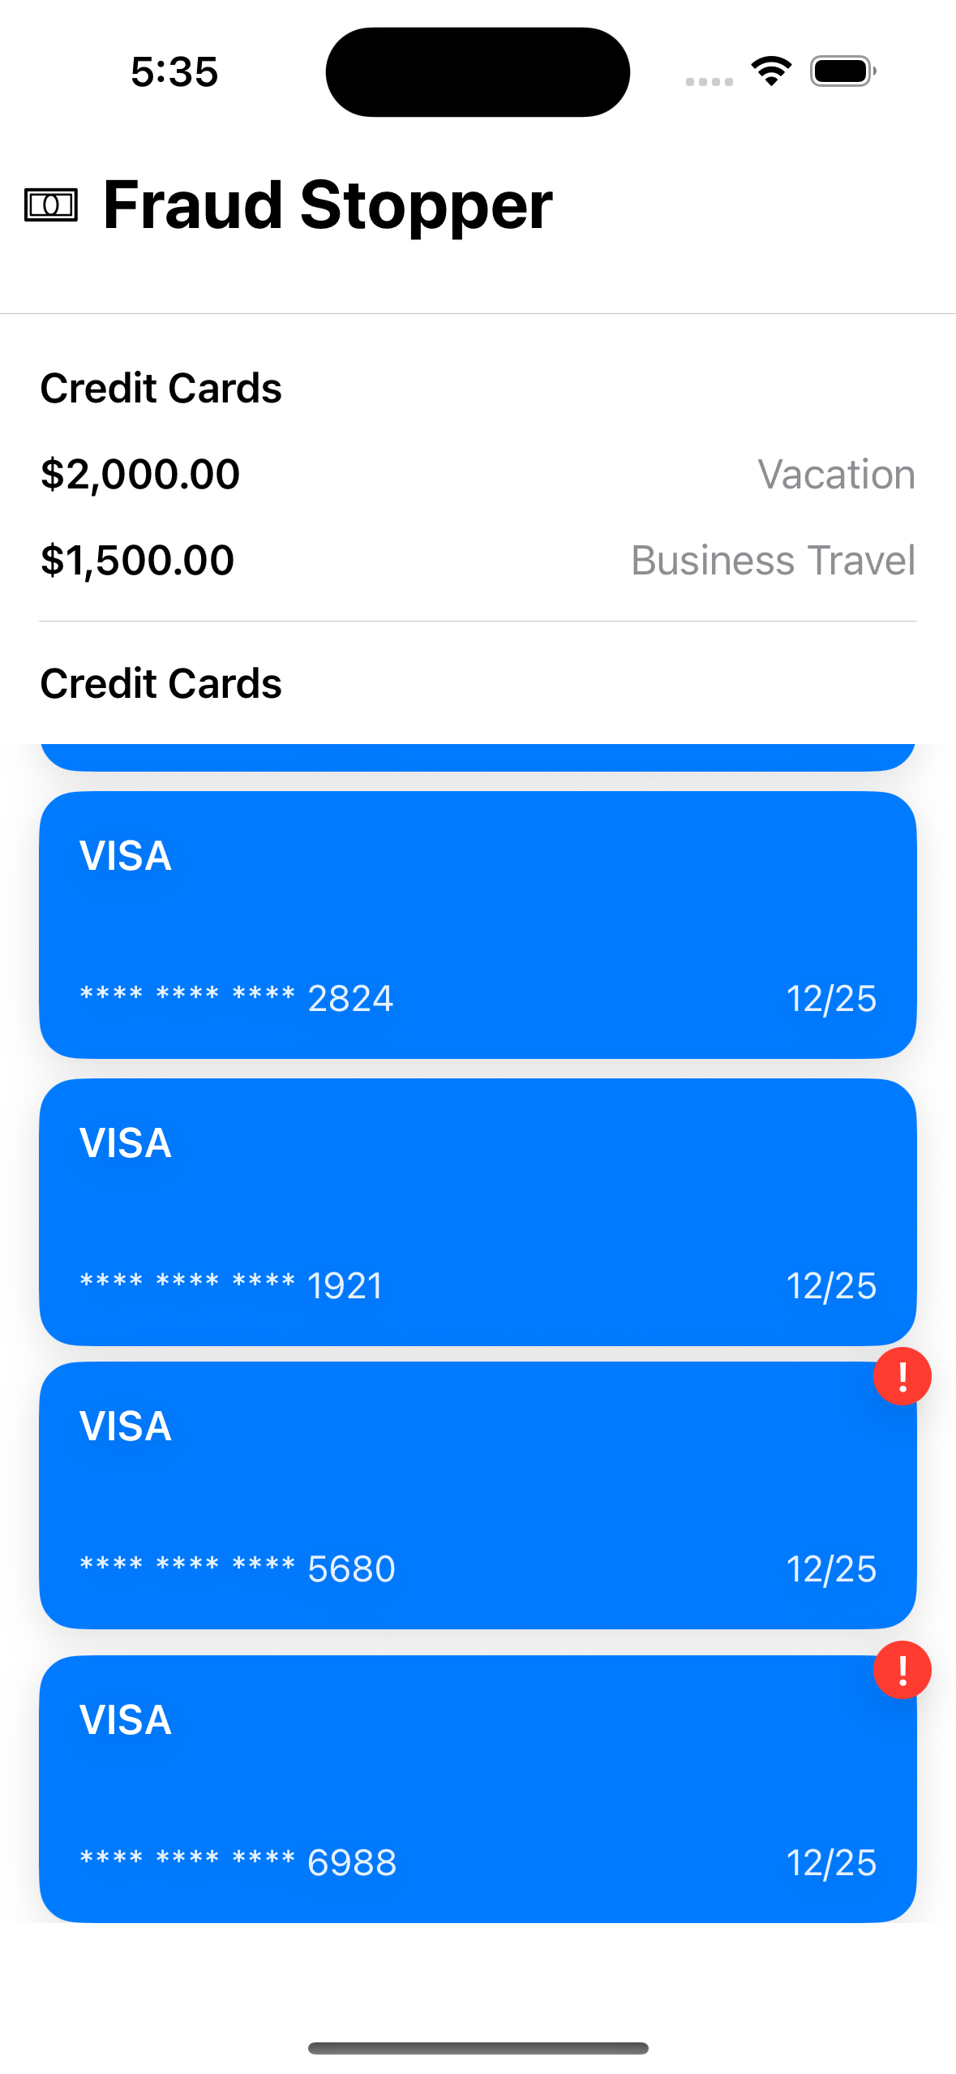
Application Screenshots
The Homepage shows a list of user credit cards, cards that have experienced fraudulent transactions will have a red exclamation badge to indicate the fraud to the user
The User can scroll their list of credit cards and can click into a credit card to view the transactions for that card (shown on the next page)

Slide 42
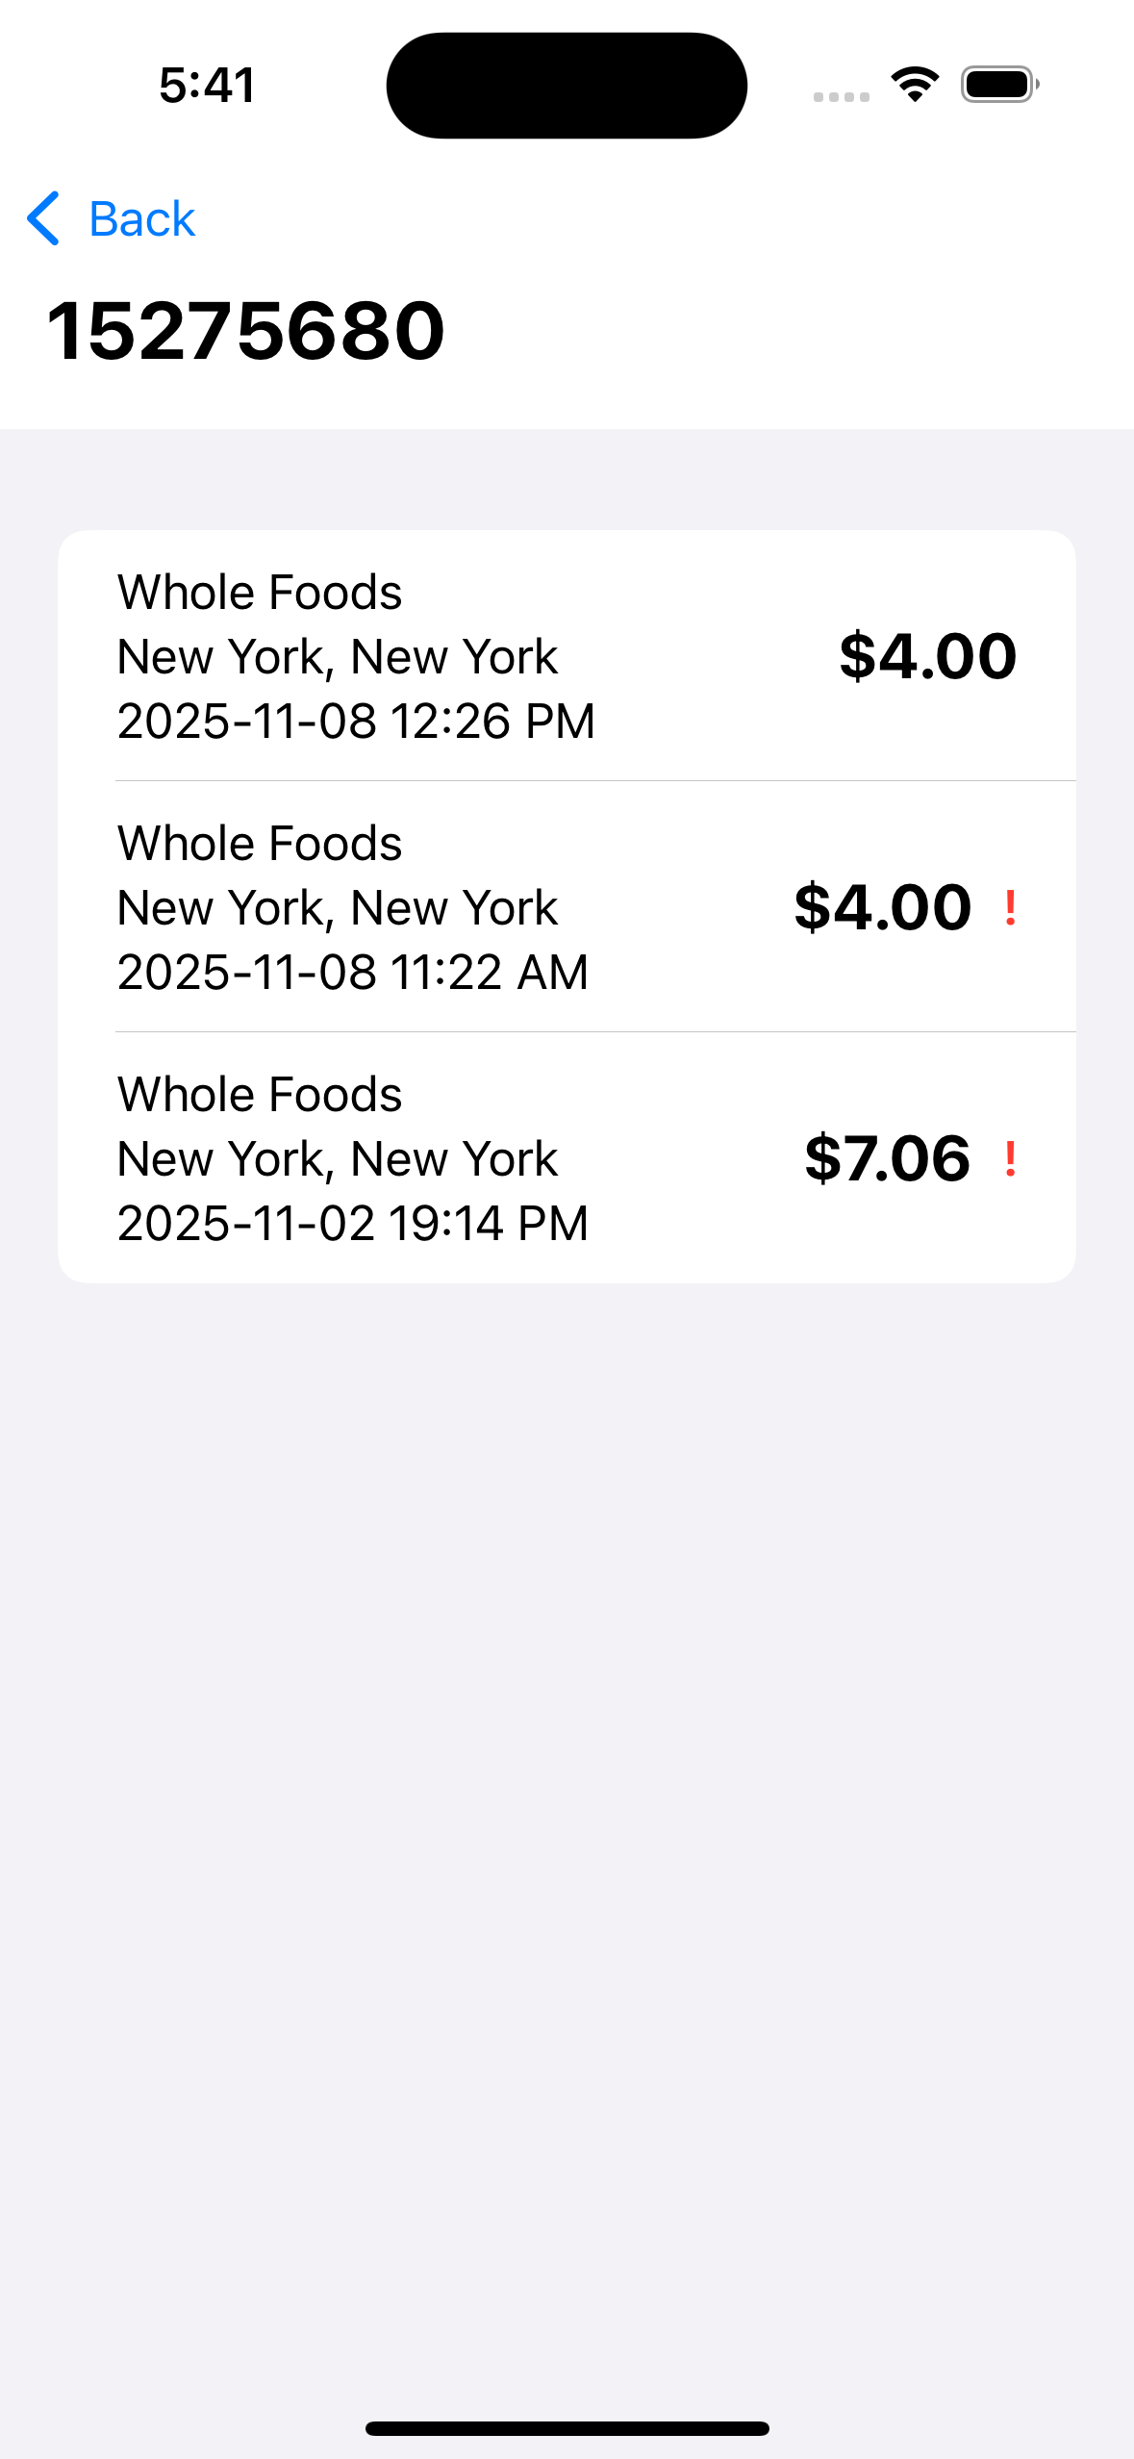
Application Screenshots
This page shows a list of transactions for a specific credit card
The credit card number is shown at the top of the list as a header
A transaction row contains the location, city, state, and time of transaction along with the amount
If a transaction is believed to be fraudulent it will have a red exclamation point to the right of its transaction amount

Slide 43
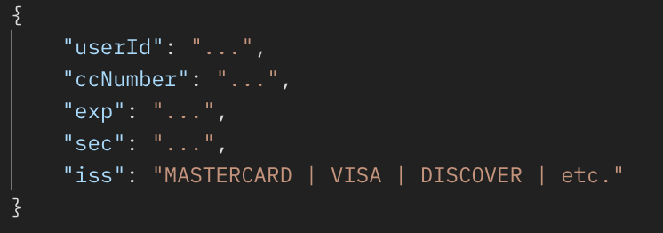
REST API
All APIs routes require an API secret in the auth header in-order to access the route
User ID information is also included in the http header rather than the URL
GET /functions/v1/app-middleware/user : Retrieves all user information such as name, email, and list of credit cards
POST /functions/v1/app-middleware/creditcard : Adds a new credit card to the user's account
GET /functions/v1/app-middleware/dailyreport?startTime=<…>&endTime=<…>​
If the user is an admin they can use this route to access a daily report of fraudulent transactions​
​
GET /functions/v1/app-middleware/transactions?ccNumber=<…>​
Retrieves all transactions for a user, with the option to get transactions only for a specific credit card

Slide 44
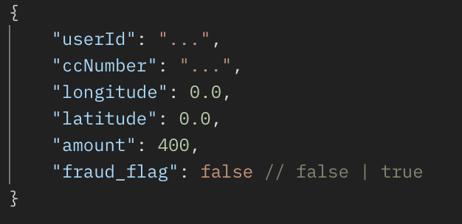
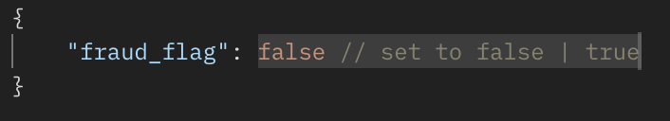
REST API - Continued
POST /functions/v1/app-middleware/transactions : Create a new transaction
PUT /functions/v1/app-middleware/transactions : Update the state of a transaction, primarily fraud status

Slide 45
WIKI Page & Github Repository
IT Architects Wiki Page
IT Architects Github Repository

Slide 46
Project Demo

Slide 47

Thank You

